Slide 1

Azure Cosmos DB
Fast NoSQL database with open APIs for any scale

Slide 2
Agenda
Introduction
Resources and Throughput
Querying data in the SQL API
Developing using the SQL API

Slide 3






Modern life is app-centric
Today’s apps deliver innovation in all facets of life
Notes:
Let’s talk about the world we live and work in today
Modern life is app-centric: businesses are reliant on applications and, increasingly, so are our homes and personal lives
For businesses, innovation is brought to life through apps as we find new ways to remain competitive and ensure business continuity during uncertain times

Slide 4


A quick scenario
Customer
ID
Full Name
Email Address
Address
Notes:
Start with a fictional retail company
Today, AdventureWorks sells a variety of outdoor sporting products to customers around the world
A “customer” record consists of multiple fields, but we are only showcasing a few here
Note for presenter: AdventureWorks’ data can be found on GitHub: https://github.com/azurecosmosdb/cosmicworks

Slide 5

Apps run on data
Real-time data from different sources and in different forms power modern apps
Notes:
As apps have become mission-critical at work and home, so, too, has data
Apps exist to use and move data; without it, apps offer little functionality and usefulness
For many years, relational SQL databases served as the end-all solution to store data for apps

Slide 6

A relational model
v1
Customer
ID: | 0012D555-C7DE
FullName: | Franklin Ye
EmailAddress: | fye@adventure.works
Address: | 9505 Hargate Court Bellflower, CA 90706 US
Notes:
If we had to store our data in a relational SQL database, this is one way we can represent that data
Thank of it as a complete object model of the domain for this application
As it stands, this model is fairly rigid
The Address field, specifically, is just a string

Slide 7
Evolving the model
v1
v2
Customer
ID: | 0012D555-C7DE
FullName: | Franklin Ye
EmailAddress: | fye@adventure.works
Street: | 9505 Hargate Court
City | Bellflower
State | CA
Zip | 90706
Country | United States
Notes:
Because the address is a rigid string, it would require our developers to do a lot of formatting and parsing to access or update specific properties of an address
We could split the address into multiple fields in the same table
We still face some challenges:
What about multi-line street addresses?
What about mail with an “ATTN” line?

Slide 8

Developers have new requirements
Today, devs need the flexibility to enable rapid app development, the responsiveness to manage changes, and the ability to handle high data volumes
Notes:
This means that application developers need to leverage data in new ways
Developers need to work with constantly changing data formats without slowing down
The database developers work with needs to minimize the amount of effort required to update our data’s shape

Slide 9
Splitting the model
v2
v3
Customer
ID: | 0012D555-C7DE
FullName: | Franklin Ye
EmailAddress: | fye@adventure.works
Address
Street: | 9505 Hargate Court
City: | Bellflower
State: | CA
Zip: | 90706
Country: | United States
Notes:
The address is still part of the customer entity
Anytime we need to modify the address for new developer requirements, we must modify the entire customer table
We can normalize the database by splitting the address data out into its own record
This also allows a customer to have more-than-one address
While this is a better solution, it’s still a band-aid to the overall problem of trying to put a flexible data type in a rigid database

Slide 10

Complex addresses
v3
v4
Customer
ID: | 0012D555-C7DE
FullName: | Franklin Ye
EmailAddress: | fye@adventure.works
Address
Street: | 9505 Hargate Court
City: | Bellflower
State: | CA
Zip: | 90706
Country: | UNITED STATES
Address
Street: | 283 Rue Villedo
City: | Villeneuve-d’Ascq
State: | NULL
Zip: | 90706
Country: | France
Notes:
Let’s consider an example scenario; Our customer has two addresses in two different countries:
Each address has it’s own unique format based on the mailing requirements of that country
This customer has an address in France and in the US with mail being sent domestically from each country
The French address does not require a “State” field
Some addresses require some fields while others do not
If you are using a relational database, every address record is rigid and will include a union of all possible fields
This can make development very difficult when developers must consider so many possibilities

Slide 11

Complex addresses
v4
v5
Customer
ID: | 0012D555-C7DE
FullName: | Franklin Ye
EmailAddress: | fye@adventure.works
Address
Street: | 9505 Hargate Court
City: | Bellflower
State: | CA
Zip: | 90706
Prefix: | NULL
Country: | United States
Address
Street: | 863 Sunshine
City: | Freeport
State: | NULL
Zip: | NULL
Prefix: | The
Country: | Bahamas
Address
Street: | 283 Rue Villedo
City: | Villeneuve-d’Ascq
State: | NULL
Zip: | 90706
Prefix: | NULL
Country: | France
Notes:
What is our customer would like a package delivered to their hotel in the Bahamas?
There’s a couple of things you should consider:
The Bahamas does not have a postal code system
The word “Bahamas” typically include a prefix of “The” when used in mailing addresses
So we increase the complexity of the Address table, once again making our developer’s lives more difficult

Slide 12



Complex addresses
v5
v6
Customer
ID: | 0012D555-C7DE
FullName: | Franklin Ye
EmailAddress: | fye@adventure.works
UnitedStatesAddress
Street: | 9505 Hargate Court
City: | Bellflower
State: | CA
Zip: | 90706
FranceAddress
Street: | 283 Rue Villedo
City: | Villeneuve-d’Ascq
Zip: | 90706
BahamasAddress
Street: | 863 Sunshine
City: | Freeport
Notes:
One of the most common solutions you will see in a normalized database is to create a new table (or type) for each individual country’s address format
While this can make developers’ lives a little easier, it does lead to some very complex queries that JOIN many tables together just to get all of the address in the customer’s address book
We can do a lot better than this!

Slide 13

Modern app devs need modern databases
Notes:
Developers require new kinds of databases that can address the needs of modern apps.
NoSQL databases were designed to address these needs and unique challenges such as:
High volumes of data
Data with many different sources and forms
Dynamic data schemas to store different types of data
Using high-velocity and/or real-time data

Slide 14

A new type of database
0012D555-C7DE
Franklin Ye
fye@adventure.works
9505 Hargate Court
Bellflower
CA
90706
United States
283 Rue Villedo
Villeneuve-d’Ascq
59491
France
863 Sunshine
Freeport
The Bahamas
Notes:
Consider a database that is inherently flexible
You can store data of many different types within this database without being forced to pre-define a schema or type
If your needs change, this database can change along with you without the risk of creating complex migration scripts

Slide 15
NoSQL Databases
NoSQL databases are defined by a collection of characteristics that they share rather than having a formal definition:
Non-relational
Scale-out
Schema-less
They were all born out of this desire to address new needs of cloud scale
Fast writes
No relational constraints or locks
Designed for horizontal scale
High-performance regardless of size
Notes:
NoSQL databases are defined by common characteristics they share rather than a specific formal definition
These characteristics include:
Data store is non-relational
Designed for scale-out
Does not enforce a specific schema
NoSQL databases generally do not enforce relational constraints or put locks on data, making writes fast
They are also often designed for horizontally scale via sharding or partitioning, which allows them to maintain high-performance regardless of size

Slide 16
NoSQL Databases
Documents
Most NoSQL databases fit into four data model families:
Documents
Key-Value
Graph
Column-Family
Key-Value
Graph
Column-Family
Notes:
While there are many NoSQL data models, four broad data model families are commonly used when modeling data in a NoSQL database

Slide 17
NoSQL Databases
Documents
Most NoSQL databases fit into four data model families:
Documents
Key-Value
Graph
Column-Family
Key-Value
Documents
Graph
Column-Family
Notes:
Specifically, we will drill-down into the document data model

Slide 18
Document model
ID
Customer
Documents
Full Name
Addresses
Address
Email Address
Address
Notes:
The document data model breaks data down into individual document entities
A document can be any structured data type, but JSON is commonly used as the data format
A document is an atomic entity and can have its own data form, regardless of what is stored in other documents in the same database
Because of this flexibility, there is no need for a pre-defined schema making it easier to build new applications rapidly

Slide 19
Example document (JSON)
{
"key": "string-value",
"key": 0.00,
"key": true,
"key": false,
"key": null,
"key": [
{
"array-item": "value"
},
{
"array-item": "value"
},
{
"array-item": "value"
}
]
}
Notes:
JavaScript Object Notation, or JSON, is a lightweight data format
JSON was built to be highly compatible with the literal notation of an object in the JavaScript language
Many frameworks, browsers, and even databases support JavaScript natively making JSON a popular format for transmitting and storing data
JSON is a relatively readable data format that clearly exposes its content
JSON is also relatively easy to parse and use in JavaScript applications

Slide 20
The flexibility of documents
{
"id": "0012D555-C7DE",
"fullName": "Franklin Ye",
"emailAddress": "fye@adventure.works",
"addresses": [
{
"street": "863 Sunshine",
"city": "Freeport",
"countryPrefix": "The",
"country": "Bahamas"
},
{
"street": "283 Rue Villedo",
"city": "Villeneuve-d’Ascq",
"postalCode": 59491,
"country": "France"
}
]
}
Notes:
JSON is inherently flexible allowing you to mix and match data types, simple values, arrays, or complex objects
In this example, let’s model our customer record from earlier in this presentation including only some of the addresses
Notice, we can flexibly store different types of addresses in our document store?
In this example:
The Bahamian address has a prefix of “The”
The French address requires a postal code while the Bahamian address does not

Slide 21


The flexibility of documents
{
"id": "086C40C9-F617",
"fullName": "Trish Xu",
"addresses": [
{
"street": "9505 Hargate Court",
"city": "Bellflower",
"state": "CA",
"postalCode": 90706
},
{
"street": "1433 C Mt Hood Crest",
"attn": "Xu Family",
"city": "London",
"postalCode": "W10 6BL",
"country": "United Kingdom"
}
]
}
Notes:
We can add even more address formats with different requirements
In this example:
We omit the country field for US addresses
We omit the state field for a UK address
This specific UK address has an attention field
The postal code for US addresses is a numeric value
The postal code for UK addresses is a string value

Slide 22


The flexibility of documents
{
"id": "086C40C9-F617",
"name": {
"given": "Trish",
"surname": "Xu"
},
"emailAddresses": [
"txu@adventure.works",
"trish.xu@personal.domain"
],
"addresses": [
...
]
}
Notes:
We can even evolve our documents as our developer’s needs change
In this example:
The dev team need the customer’s name split into a given name and surname for automated messaging
The dev team also recognized that a customer may have more than one email address

Slide 23


The flexibility of documents
{
"id": "086C40C9-F617",
"name": {
"given": "Trish",
"surname": "Xu"
},
"email": [
{
"address": "txu@adventure.works",
"type": "office",
"primary": true
},
{
"address": "trish.xu@my.domain",
"type": "personal"
}
],
"addresses": [ ... ]
}
Notes:
The beauty of a flexible document-based data store is that you can keep evolving your model and adapting to new customer requests or business priorities
In this example:
Customers would like to flag a “primary” email address
Customers would like to distinguish between “office” and “personal” email addresses
How would you evolve this model?

Slide 24

Azure Cosmos DB SQL API
Fast NoSQL document database for applications of any scale
Supports JSON natively
SDKs for popular frameworks
Rich querying with SQL syntax
Supports data of many forms and velocities
Documents
Notes:
Azure Cosmos DB is ideally suited for modern application development
Azure Cosmos DB SQL API is especially suited for applications that:
Experience unpredictable spikes and dips in traffic
Generate lots of data
Need to deliver real-time user experiences
Are depended upon for business continuity
The Azure Cosmos DB SQL API can arbitrarily store native JSON documents with flexible schema
Data is indexed automatically and is available for query using a flavor of the SQL query language designed for JSON data
The SQL API can be accessed using SDKs for popular frameworks such as .NET, Python, Java, and Node.js.

Slide 25
Guaranteed speed at any scale
Propel your app development into the future with Azure Cosmos DB
Simplified app development
Mission-critical ready
Fast NoSQL Database with open APIs for any scale
Fully managed and cost-effective
Notes:
At a step up, the overall Azure Cosmos DB platform has many advantages including:
Guaranteed speed at any scale—even through bursts—with instant, limitless elasticity, fast reads, and multi-region writes, anywhere in the world
Fast, flexible app development with SDKs for popular languages, a native SQL API along with APIs for MongoDB, Cassandra, and Gremlin, and no-ETL (extract, transform, load) analytics
Ready for mission-critical applications with guaranteed business continuity, 99.999-percent availability, and enterprise-grade security
Fully managed and cost-effective serverless database with instant, automatic scaling that responds to application needs
These advantages exist across multiple APIs, but we will only focus on the SQL API

Slide 26
Azure Cosmos DB
Develop modern apps with SLA-backed speed and availability, automatic and instant scalability, and open source APIs for many NoSQL engines
Guaranteed speed at any scale
Mission-critical ready
Gain unparalleled SLA-backed speed and throughput, fast global access, and instant elasticity.
Guarantee business continuity, 99.999% availability, and enterprise-level security for every application.
Simplified app development
Fully managed and cost-effective
Build fast with open source APIs, multiple SDKs, schema-less data, and no-ETL analytics over operational data.
End-to-end database management with serverless and automatic scaling matching your application and TCO needs.
Notes:
At a step up, the overall Azure Cosmos DB platform has many advantages including:
Guaranteed speed at any scale—even through bursts—with instant, limitless elasticity, fast reads, and multi-region writes, anywhere in the world
Fast, flexible app development with SDKs for popular languages, a native SQL API along with APIs for MongoDB, Cassandra, and Gremlin, and no-ETL (extract, transform, load) analytics
Ready for mission-critical applications with guaranteed business continuity, 99.999-percent availability, and enterprise-grade security
Fully managed and cost-effective serverless database with instant, automatic scaling that responds to application needs
These advantages exist across multiple APIs, but we will only focus on the SQL API

Slide 27



Azure Cosmos DB powers real-time apps anywhere in the world
Personalization and recommendations
IoT device telemetry
Global, mission-critical
Notes:
Some of the most popular use cases for Azure Cosmos DB include
IoT device telemetry
Real-time personalization
Serving dispersed user bases.

Slide 28


Mercedes-Benz
A cloud-native IoT solution for an in-car digital experience that runs on Azure Cosmos DB and Azure Kubernetes Service
Azure Cosmos DB delivers:
geo-redundancy
high availability
low latency reads and writes worldwide

Slide 29

“Our software development process is so much better now. We’re able to keep the software inside of the cars updated and release new features in weeks instead of months, while preserving quality and security of vehicle and driver data.”
Rodrigo Nunes
Principal software engineer, Mercedes-Benz, R&D

Slide 30




Stay agile with real-time telemetry on Azure Cosmos DB
Azure Iot Hub
Azure Databricks Spark (Structured Streaming)
Azure Cosmos DB (Hot)
(TTL = 90 days)
Azure API App (user facing app)
Azure Function (triggered via Cosmos DB change feed)
Azure Storage (Cold)
Azure Synapse Analytics (Cold)
(Summarized Telemetry)
Power BI Dashboard
Notes:
Get insights into operations, assets, and inventory to improve business performance and user experience. With Azure Cosmos DB, developers can easily ingest and manage high-velocity telemetry, fleet data, and supply chain data - in real-time, anywhere in the world, and in a cost-effective way.
Azure Cosmos DB is great for this use case because it offers:
Unlimited elastic and instant throughput
<10 ms read and write latency SLA
Autoscale pricing model matches capacity to demand
Auto-indexing of semi-structured data
Turnkey multi-region writes
99.999% availability SLA worldwide

Slide 31


ASOS
Real-time product recommendations and instant order updates for 15mm+ global customers.
Azure Cosmos DB delivers:
<10 ms latency reads and writes
Global data distribution
Instant elastic scalability
Change feed for order workflows and microservices
Notes:
Challenge
ASOS ecommerce platform needed to offer real-time product recommendations and scale to meet seasonal demand and instant update with high reliability in any location.
Outcome Reimagined microservices architecture in a global distribution of 30 datacenters that ensures automated resiliency and high levels of performance for customers in any location, and a recommendations platform for 15mm+ customers includes 85,000 products, with 5,000 new ones added each week.
ASOS uses Azure Cosmos DB across numerous microservices, including:
low-latency data store for tasks such as storing and retrieving precalculated user profiles and product machine learning models to generate real-time recommendations
Order workflows using change feed functionality to broker communication between event-driven microservices that handle various stages of the order workflow as a persistent event store, so customers can easily track their orders
easy-to-use online returns process. Customers can request a return online, download the return label, and get refunded with just a few easy steps

Slide 32

“We chose Azure Cosmos DB because of its global distribution and ability to handle heavy seasonal bursts like Black Friday.”
Bob Strudwick
Chief Technology Officer

Slide 33




Online Recommendations Service
HOT path
Azure Service Fabric
(Personalization Decision Engine)
Azure Cosmos DB
(distributed model store)
Personalize digital experiences with 360-degree customer view
Shoppers
.com
(Product details page)
Azure Data Factory
(scheduled job to refresh persisted models)
Azure Event Hub
Azure Data Lake Storage
(offline raw data)
Apache Spark on Azure HDInsight
Offline Recommendations Engine
COLD path
Notes:
Leverage CRM and clickstream data throughout the user journey to deliver recommendations, personalized experiences, and more
Azure Cosmos DB is great for this use case because it offers:
Unlimited elastic and instant throughput
<10 ms read and write latency SLA worldwide
Turnkey multi-region writes
99.999% availability SLA worldwide
Auto-indexing of semi-structured data
Ingest high volumes of data from multiple sources

Slide 34


Coca-Cola
A sales revenue solution gathers data from business units across 200+ countries, for insights in minutes.
Azure Cosmos DB delivers:
Global data distribution
Ingestion of PBs of data
Unlimited scale
Enterprise-grade service
Notes:
https://youtu.be/DqQuXGjaE8c

Slide 35

“Being able to scale and have insights that are actually delivered within minutes is very important to us”
Neeraj Tolmare
CIO and Global Head of Digital & Innovation, The Coca-Cola Company

Slide 36

Azure region A
<10 ms
Azure Cosmos DB (app + session state)
Put your data where your users are
Azure Traffic Manager
Azure region B
<10 ms
Globally distributed across regions
Azure region C
<10 ms
Notes:
Deliver consistent, real-time, and always-on experiences anywhere with guaranteed performance.
Azure Cosmos DB offers:
One-click data distribution to any Azure region in the world
Turnkey multi-region writes
<10 ms read and write latency SLA
99.999% high-availability SLA
0 RPO and RTO
Choice of five data consistency models

Slide 37
Why use Azure Cosmos DB SQL API?
Notes:
Each resource is uniquely identified by a stable and logical URI and represented as a JSON document
The overall resource model of an application using Azure Cosmos DB is a hierarchical overlay of the resources rooted under the database account, and can be navigated using hyperlinks
Except for the item resource, which is used to represent arbitrary user defined JSON content, all other resources have a system-defined schema
Container and item resources are further projected as reified resource types for a specific type of API interface
For example, while using document-oriented APIs, container and item resources are projected as collection (container) and document (item) resources

Slide 38
Guaranteed speed at any scale
Latency
High Availability
Real-time access
Fast read and write latencies globally
<10 ms read and write latencies
Throughput and consistency all backed by SLAs
Elastically scale storage and throughput
Across any Azure region
Even during unpredictable traffic bursts
Achieve unlimited scale worldwide
<10 ms
99th percentile
99.999%
Throughput
Consistency
Guaranteed
Guaranteed
Notes:
Real-time access with <10 ms read and write latencies backed globally by SLA
The only service with financially-backed SLAs for millisecond read and write latency at the 99th percentile and 99.999% high availability
Independently and elastically scale storage and throughput across any Azure region

Slide 39



Simplified app development
SQL API
NoSQL schema flexibility
Deep integration with other Azure services
Languages of your choice with SDKs for
.NET
Java
Python
Node.js
Change feed to track and manage changes
Notes:
The NoSQL schema flexibility removes the impedance mismatch between application object model and the database.
Deep integration with key Azure services used in cloud-native app development including Azure Synapse Analytics
Languages of your choice with SDKs for .NET, Java, and Python
Change feed makes it easy to track and manage changes to database containers

Slide 40
Mission-critical ready
Comprehensive suite of SLAs
Industry-leading 99.999% availability worldwide
Strong consistency for RPO = 0
Turnkey data distribution to any Azure region
Multi-region writes for RTO = 0
Enterprise-grade end-to-end encryption
Enterprise-grade self-managed keys
Client-side encryption
Azure AD integration and RBAC
Notes:
Azure Cosmos DB offers a comprehensive suite of SLAs including industry-leading 99.999% availability worldwide
Azure Cosmos DB delivers zero downtime with 0 RPO
Turnkey multi-region writes and data distribution to any Azure region is enabled by a click of a button
Turnkey multi-region writes enabled by a click of a button
Enjoy enterprise-grade end-to-end encryption and self-managed keys
Role-based access control (RBAC) keeps your data safe and offers fine-tuned control

Slide 41
Fully managed service
Fully managed database service
Automatically handles maintenance/updates
Cost-effective serverless database operations model
Responds to app patterns
Suited for small, spiky workloads with moderate performance requirements
Autoscale provisioned throughput
High-performance guarantees for critical workloads
Eliminates the need for direct throughput management
Notes:
Fully managed database service automatically handles all maintenance and updates
Cost-effective serverless database operations model responds to app patterns and is ideally suited for small, spiky workloads with moderate performance requirements
Autoscale provisioned throughput offers high-performance guarantees for critical workloads while eliminating the need for direct throughput management

Slide 42
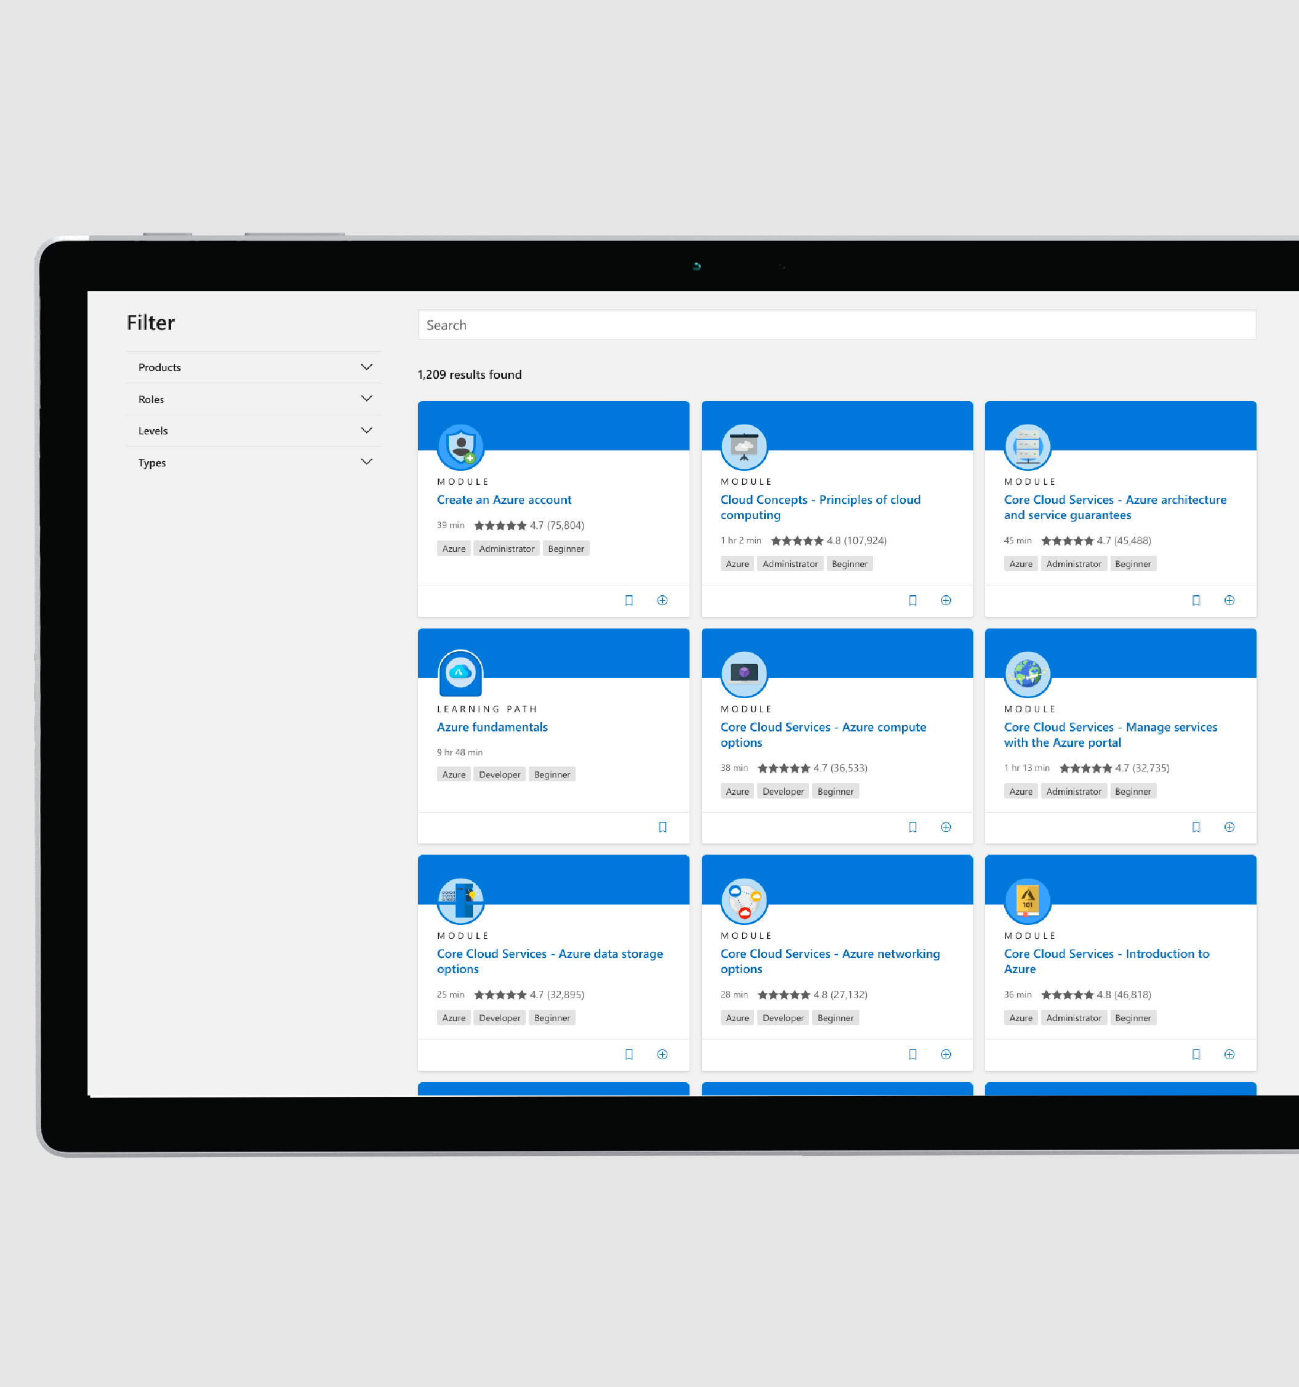
Keep on with Microsoft Learn
Review an interactive course with videos and knowledge checks
Introduction to Azure Cosmos DB Core API @ docs.com/learn

